Slide 1
Processes
Module 4

Slide 2
Objectives
Identify the types of Processes (WorkFlow, Action, Dialog, Business Process Flow)
Compare the scope, flexibility and maintenance of the different types
Understand core Process designer features
Examine the steps involved in developing and deploying custom workflow activities
Create custom workflow activities

Slide 3
Objectives
Debug custom workflow activities
Understand declarative workflows and their limitations
Create an Action and invoke it through code
Create a Business Process Flow and modify the process in code

Slide 4
Processes vs Plugins
Reasons to use WorkFlows to host business logic
Restriction | Solution
Changes to business logic need to be made by non developers | Crm users can create, edit, reorder the steps of a process
Need to run when user decides | Crm users can select to run an on demand workflow
Running CRM online | Declarative workflows, can not be registered for CRM online, so need to use plugins
Complex logic that needs multiple conditions, loops, read external data sources | Process steps and conditional options supplied through the designer are limited compared to writing a plugin in .Net. However, Complex logic can be performed by .Net components used inside processes (Custom Workflow Activities) or used to invoke processes (Actions)
Running the logic real time | CRM workflows can now run synchronously as well as asynchronously just like plugins
Notes:
Reasons to Use Plugins
Complex business logic, that needs to refer to external systems
The logic needs to run immediately – although Real Time Workflows run Synchronously, they can be resource intensive
They need to run online
They need to run by impersonating another user.
Reasons to Use Processes
Simple logic that can be defined graphically through the process designer by non programmer
The logic needs to run immediately (Real Time Workflows run Synchronously) or as a background process
They need to be updated without having to recompile and update a registered component.

Slide 5
Process options
Available to create through the processes editor dialog
Process | Description
Workflow | Created as a series of steps in CRM designer or externally as XAML. Auto-started or run on demand by user.
Dialog | Created only through CRM designer, and can only be user started
Action | Business logic unit created from process steps, can be assigned to an entity or all. Can have input and output parameters. Invoked through an OrganizationRequest message in code
Business Process Flow | A visualisation of the progress of an entity through a defined business process
Notes:
WorkFlow, Dialog and Actions all define a sequence of steps (executing commands). The choice of steps available is process type dependent, run child dialog, and lookup crm data are only available from a dialog, but many such as run workflow, check condition, assign value, stop workflow, create record, update record, change status are common to all process types. The limitations of the steps available is bypassed by the ability to register Custom WorkFlow Activities, which are .Net assemblies with the rich programming capabilities of accessing the CRM and other external systems. Custom WorkFlow Activities are available through the Process designer add – step.
Workflows and Dialogs are considered in the CRM Customization Course
Importing data for entities that have real-time workflows can have a severe impact on system resources. Real-time workflows trigger whether resources are available or not. They also access the whole CRM record rather than just the updated values as with a Plugin triggered on an update.
Use the RealTime WorkFlow when results need to occur immediately without the use of JavaScript programming. And when development time / costs are at a premium
Use Synchronous Pluguns when the need to reduce system resources is high,( if a very high throughput for a particular function with a high degree of concurrency is needed)

Slide 6
Business Process Flows
Available to be enabled on many system entities and custom entities
Span Multiple Entities
Role Tailored
Switch on the fly
Can contain Process Branching based on condition
Process definition included in Solutions
Notes:
The great thing about business process flows is that you do not have to be a developer or an administrator to understand how to build a business process flow in Dynamics 365.
One OOB Business Process Flow is the Lead to Opportunity flow that revolves around the process of qualifying a lead.
After you create a business process flow, you need to enable the security roles of those who are going to use it. This allows people with the security role to assign the process to new and existing records.
https://www.microsoft.com/en-us/dynamics/crm-customer-center/create-a-business-process-flow.aspx

Slide 7
Capabilities of Business Process Flows
Each process can contain up to 30 stages
Multi-entity processes can contain up to 5 entities
There can be up to 10 activated business process flow processes per entity
Users can switch processes if they need to
Business process flows can be restricted by Security Roles; order determines default used

Slide 8
Actions
Created using the process editor with Process steps defined and managed in CRM designer. So can be edited by non developer
Process can define input and output parameters to receive from and pass back to calling code
Exposed as a custom OrganizationRequest, CRM Messages that work with the typical CRM Request/Response pattern
Built on top of the process infrastructure, but execute real time
Cannot call from another declarative process except indirectly through a custom workflow activity, plug-in, or an application that uses the organization service. Can be invoked only from managed code, client script or external client applications
Can be generic and not fixed to a single entity like workflow, dialog and business process flow
Notes:
Actions provide a hybrid business logic, combining the simplicity of the process designer in organising a sequence of commands, with the superior logic capabilities of the managed code development environment to pass appropriate parameters and control when the action is triggered.
From the developers perspective an Action is exposed as a single OrganizationRequest Message to be executed through the OrganizationService, thus abstracting all the process steps/commands included to just one method call.
From the CRM users perspective an Action is an editable sequence of commands, created by design, that is explicitly exposed to be run by managed code, but can be deactivated, or modified outside of compilation.
Unlike workflow processes, you don’t need to set the following options:
Start When: Actions start when code calls the message generated for them.
Scope: Actions always run in the context of the calling user.
Run in the background: Actions are always real-time workflows.
An action also has something that workflow processes don’t have – input and output arguments.

Slide 9
Notes:
Process steps defined and managed in CRM designer using the standard action steps or even custom workflows . So can be edited by non developer, changing default parameter values, changing the values of record assignments, task and email messages, etc.
Process run through code only, so only used by external applications, or indirectly in CRM through plugin or custom workflow activity. It can not be directly triggered by CRUD events or user “on demand”.
Process can define input and output parameters to interact with calling code, for example an emailing process could be suggesting some product based on age and location of customer.
Exposed as an OrganizationRequest message to the developer, using the CrmSvcUtil.exe with the flag /generateActions, any activated Actions will be generated as a custom OrganizationRequest and corresponding OrganizationResponse, containing the input and out parameters as properties respectively.
Can be generic and not fixed to an entity like workflow, dialog and business process flow, so could have an action that is invoked to run a series of commands (create audit record, create task) for any entity.
https://msdn.microsoft.com/en-us/library/dn481600.aspx

Slide 10
Notes:
Both input and output arguments must have a name, a type, and some information about whether the argument is always required. You can also provide a description. The name of the message and the information about all the process arguments represent the “signature” for the message. After an action is activated and it is being used in code, the signature must not change. Changing this signature will cause any code that uses the message to fail. The only exception to this may be changing one of the parameters so that it is not always required. Changing the order of the arguments by sorting them or moving them up or down doesn’t make a difference because the arguments are identified by name, not by the order. Changing the description will not break code using the message.

Slide 11
Notes:
Global messages:
Unlike workflow processes or plugins, an action doesn’t have to be associated with a specific entity. You can define ”global” Actions that can be called on their own.

Slide 12
Workflow
Rules
The workflow process, binding the trigger event to execute the actions
Events
The triggers to invoke the process, record created, assigned, deleted, attributes changed
Actions and Conditions
Steps of process – assign, create, send email, trigger custom workflow action, start a child workflow
Notes:
WorkFlows are a declarative design business logic component, that can be executed in response to a CRUD operation of a record, or on-demand through the UI. The sequence of steps (commands) that can be executed when the WorkFlow is triggered is limited hence the need for Custom WorkFlow Activities which allow the CRM user to add a WorkFlow step that runs a compiled .Net Assembly.

Slide 13
RealTime WorkFlow
Asynchronous WorkFlows run in background so system changes not displayed to user
Users see the results of RealTime WorkFlow without refresh
RealTime WorkFlow could be used for validation like Business Rules
Triggers after record is created, but before or after; status changes, or record assigned, or field changes and before record deleted
Can execute with permissions of WorkFlow owner or as running user
Like plugins they can be ranked within pipeline phase
Unlike Asynchronous WorkFlow they cannot contain delays
Notes:
CRM 2015 introduced Real time workflows, so plugins are no longer needed for Synchronous work. The option to allow workflows to be synchronous, allows a workflow process to participate in the database transaction, and also to see the results of the WorkFlow in the UI without having to refresh. This is not as flexible as plugins with the pre and post database event but offers a new declarative option in choosing the location of business logic. However running synchronously means the RealTime WorkFlow cannot contain delays or waits and only errors are logged; cannot view process history. This limits the ability to debug issues.
Importing data for entities that have real-time workflows can have a severe impact on system resources. Real-time workflows trigger whether resources are available or not. They also access the whole CRM record rather than just the updated values as with a Plugin triggered on an update.
Use the RealTime WorkFlow when results need to occur immediately without the use of JavaScript programming. And when development time / costs are at a premium
Use Synchronous Pluguns when the need to reduce system resources is high, (if a very high throughput for a particular function with a high degree of concurrency is needed)
https://community.dynamics.com/crm/b/nunoscrmblog/archive/2017/06/29/real-time-workflow-vs-plugin-execution-order
By default real-time workflows are executed before than plugins steps;
Plugin steps are executed before than real-time workflows when both have set the same rank.

Slide 14
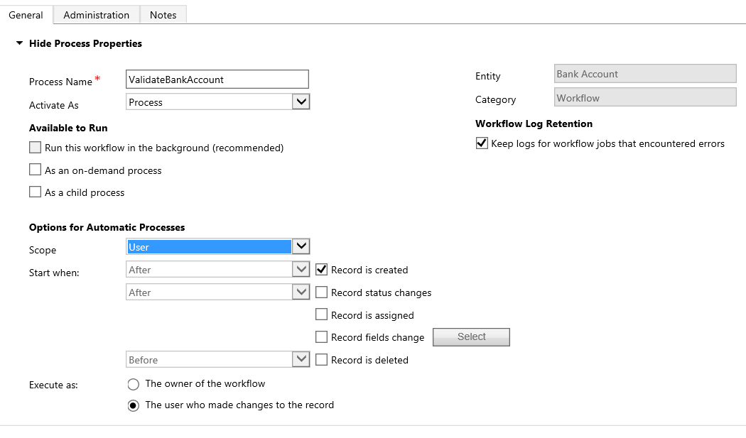
Creating RealTime WorkFlow
Notes:
When selecting RealTime WorkFlow the process designer gives options for the phase of the process pipeline in which to execute the WorkFlow, the trigger to start the WorkFlow, and the user to execute the WorkFlow.
Demo: Create a RealTime WorkFlow to validate the Create of a Conact if the Lastname is Fred, use a condition to check the lastname, and a stop workflow step with an error message. Observe it prevents Save of the record.

Slide 15
Executing Workflow programmatically
ExecuteWorkflowRequest request = new ExecuteWorkflowRequest()
{
WorkflowId = _workflowId,
EntityId = _leadId
};
// Execute the workflow.
ExecuteWorkflowResponse response = (ExecuteWorkflowResponse)serviceProxy.Execute(request);
Notes:
programmatically execute a workflow by using the ExecuteWorkflowRequest

Slide 16
Dialogs
Input Arguments
Variables
Pages
Prompts and Responses
Actions and Conditions
Notes:
Like the WorkFlow the dialog is a sequence of commands (steps) that are conditionally executed based on the input from a series of prompts and answers. The list of steps is:
Demo

Slide 17
Creating Custom Workflow Activities
Custom WorkFlow Activities are supported online with CRM 2015
Create a Workflow Activity Library in Visual Studio
Use the directives:
System.Activities;
Microsoft.Xrm.Sdk;
Microsoft.Xrm.Sdk.Workflow;
Make the class inherit from the CodeActivity Class
public class RetrieveCreditScore : CodeActivity
Add functionality to the class by adding an Execute method
protected override void Execute(CodeActivityContext context) { //Activity code}
Notes:
A Custom Workflow Activity is a strongly named .Net Assembly, with a class that derives from the WorkFlow CodeActivity Class, and overrides the Execute method where the business logic is implemented.
Visual Studio has a Worflow Activity Library template to create a Custom WorkFlow Activity.
To create a strongly named assembly use the project properties – signing tab to select a strong name key.
Example Structure
using Microsoft.Xrm.Sdk;
using Microsoft.Xrm.Sdk.Query;
using Microsoft.Xrm.Sdk.Workflow;
using Microsoft.Crm.Sdk.Messages;
using Microsoft.Xrm.Sdk.Client;
public sealed class LeadRouting : CodeActivity
{
protected override void Execute(CodeActivityContext context)
{
}
}

Slide 18
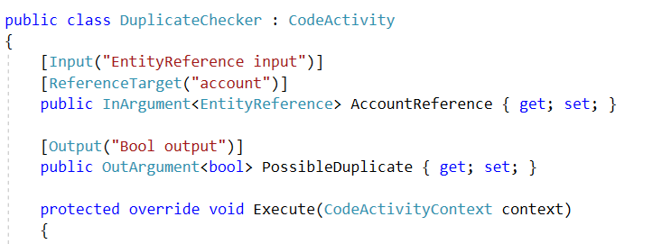
Specifying Parameters
Input / Output
Notes:
Custom WorkFlow Activities can specify inward and outward properties ( these properties are the properties associated with steps/commands in the process designer. Inward properties are entered in the designer with literal values or from the dynamic values assistant. Outward parameters can be used from parent WorkFlows to capture the product of a CustomWorkFlow as data for another step (like updating a record value)
Specific Parameter Data Types:
Bool, DateTime, Decimal, Double , EntityReference, Money, OptionSetValue, String,
ReferenceTargetAttribute:
Specifies the entity type being referenced for an EntityReference attribute. The AccountReference property is a record pointer to an account.
[Input("EntityReference input")]
[Output("EntityReference output")]
[ReferenceTarget("account")]
[Default("3B036E3E-94F9-DE11-B508-00155DBA2902", "account")]
public InOutArgument<EntityReference> AccountReference { get; set; }
https://msdn.microsoft.com/en-us/library/gg327842.aspx

Slide 19
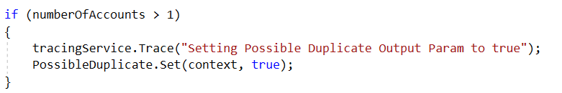
Reading and writing to the
Notes:
AttributeTargetAttribute:
Specifies the entity and the attribute being referenced by an OptionSetValue property. The following samples AttributeTarget points to the industrycode OptionSet of account
[Input("OptionSetValue input")]
[Output("OptionSetValue output")]
[AttributeTarget("account", "industrycode")]
[Default("3")]
public InOutArgument<OptionSetValue> OptionSetValue { get; set; }
RequiredArgumentAttribute:
Specify an input parameter is required.
Reading the Property Values
[Input(“Label in process designer text")]
public InArgument<string> Text { get; set; }
[RequiredArgument]
[Input("Distribute Leads Evenly")]
[ReferenceTarget("lead")]
public InArgument<EntityReference> Lead { get; set; }
protected override void Execute(CodeActivityContext context)
{
// Obtain the runtime value of the Text input argument
string text = context.GetValue(this.Text);
//or
// string text=this.Text.Get(context);
EntityReference er = context.GetValue<EntityReference>(this.Lead);
//also
//Context.SetValue(this.OutwardProperty,”new value for property”);
}

Slide 20
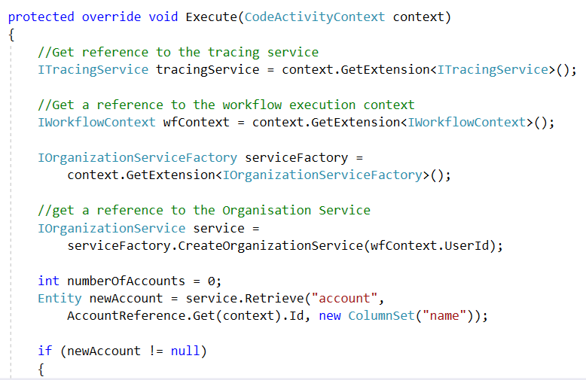
Using the CodeActivityContext
Notes:
To call Microsoft Dynamics 365 or Microsoft Dynamics 365 (online) organization web service methods from within a custom workflow activity, you must first obtain a reference to the web service.
Get a reference to IOrganizationServiceFactory.
Use the IOrganizationServiceFactory.CreateOrganizationService method to create an instance of IOrganizationService.
Use the IOrganizationService instance to call the supported methods.
The use of the CodeActivityContext also provides a reference to the WorkFlow framework. This provides context for the workflow execution including
PrimaryEntityId Gets the GUID of the primary entity for which the pipeline is processing events.(Inherited from IExecutionContext.)
PrimaryEntityName Gets the name of the primary entity for which the pipeline is processing events.(Inherited from IExecutionContext.)
The context.SharedVariables[“mysharekey”]=“value to share in pipeline”; allows another process in the pipeline to receive the shared data.
var data= context.SharedVariables[“mysharekey”];
Impersonation https://msdn.microsoft.com/en-us/library/gg309629.aspx

Slide 21
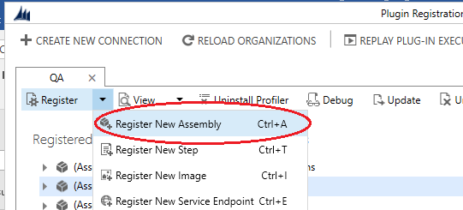
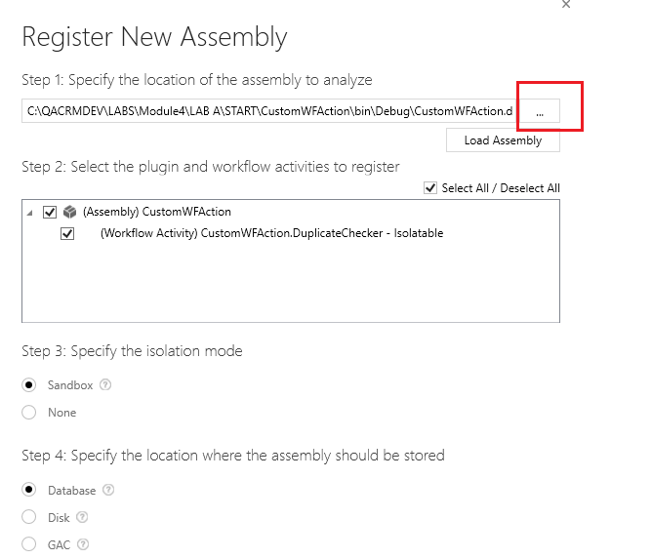
Installing and using a Custom WorkFlow Activity
Build the signed assembly
Use the Plugin Registration Tool to register the assembly
Notes:
Custom workflow activity assemblies are registered using the Plug-in Registration tool. The tool provides a graphical user interface and supports registering assemblies that contain plug-ins or custom workflow activities. When registering an assembly that contains custom workflow activities with Microsoft Dynamics 365 (online), you must register the assembly in the sandbox (partial trust).
After you have registered your custom workflow activity assembly, you can use it in the process designer in Microsoft Dynamics 365

Slide 22
Debugging Custom Workflow Activities
copy .snk file used to sign the Custom Activity assembly to the Dynamics 365 sdk \tools\PluginRegistration
rename the copy PluginProfiler.DefaultWorkflowAssembly.snk.
Install the Plugin Profiler (if not already installed by the Plugin Registration Tool)
Open the Plugin Registration tool and right click on the Plugin Profiler node and select “Start Profiling Workflow

Slide 23
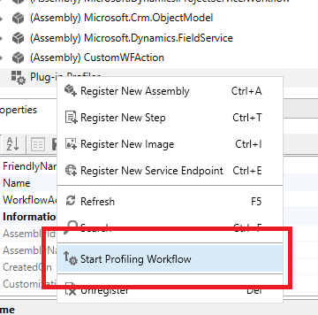
Debugging Custom Workflow Activities
copy .snk file used to sign the Custom Activity assembly to the Dynamics 365 sdk \tools\PluginRegistration
Rename the copy PluginProfiler.DefaultWorkflowAssembly.snk.
Install the Plugin Profiler
Right click to start Profiling

Slide 24
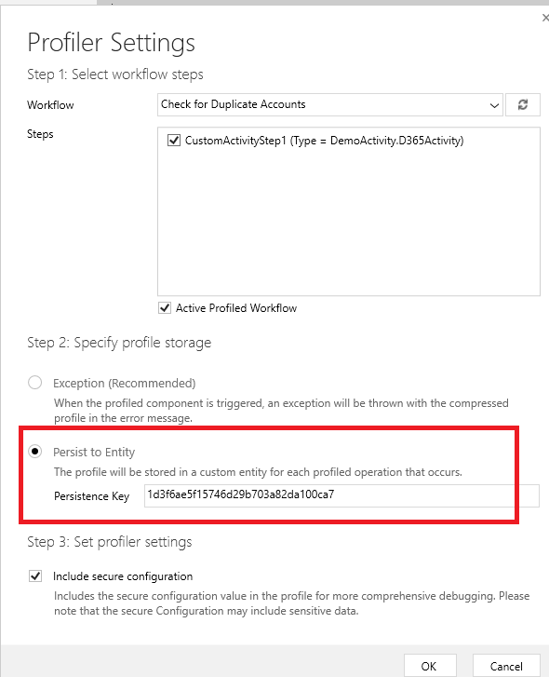
Debugging Custom Workflow Activities

Slide 25
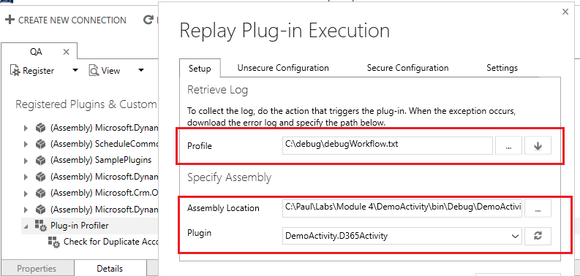
Debugging Custom Workflow Activities
Back in the plugin Registration tool click on the debug button
Load the file created by the profiler
Select the assembly located in the bin debug folder of the visual studio project

Slide 26
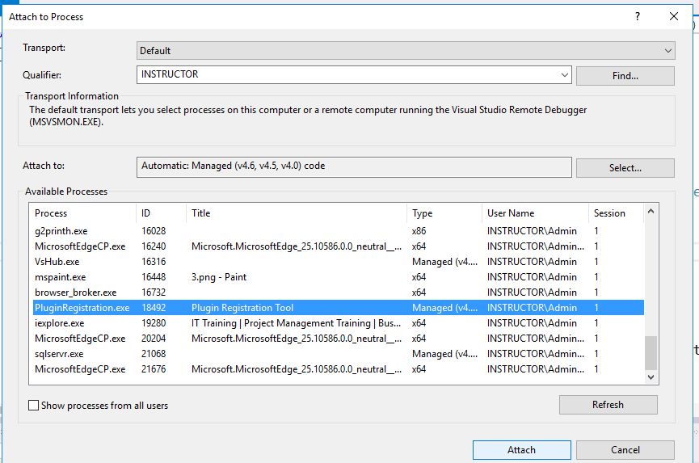
Debugging Custom Workflow Activities
On the debug menu in Visual Studio select to attach to the Plugin Registration Tool
Notes:
And

Slide 27
Debugging Custom Workflow Activities
On the debug menu in Visual Studio select to attach to the Plugin Registration Tool
Go back to the Plugin Registration Tool and click on the start execution button
Any break points that have been added to your project will cause the debugger to break on that line and allow you to step though your code
Notes:
And

Slide 28
Declarative Workflows
What are they good for?
Design generated Workflow logic in a XAML format. The wider functionality of the Visual Studio Workflow designer compared to the Dynamics 365 designer gives them greater scope with more command options. The process can be modified through the designer without writing code and the XAML imported into Dynamics 365 without compilation
Limitations
Can only be used on-premise as do not run in Sandbox. Cannot be debugged like Custom WorkFlow Activities
Pre-requisites
Declarative WorkFlows are disabled by default – so must be enabled on a Dynamics 365 system before they can be imported. They can only be used on-premise
Notes:
Enabling Declarative WorkFlows from a Power Shell Command Window
1. Add the Microsoft Dynamics CRM PowerShell snap-in:
Add-PSSnapin Microsoft.Crm.PowerShell
2. Retrieve the current setting:
$setting = get-crmsetting customcodesettings
3. Modify the current setting:
$setting.AllowDeclarativeWorkflows="True"
set-crmsetting $setting
4. Verify the setting: get-crmsetting customcodesettings
Using Visual Studio to Create Declarative WorkFlows
1.Visually create workflows without writing code. Use the Activity Library project template, with a Workflow activity as the root activity. 2.Add the Microsoft Dynamics CRM workflow activities to the toolbox. 3.Add activities to the root activity from the toolbox such as send email, create record and use the properties window to assign attributes. 4.Change the process flow of activities in a workflow, for example, reorder the Sequence activities. Create variables to hold values and references that are important to your workflow by using the variables designer. 5.Instead of starting from new, a pre-existing workflow can be exported from CRM and edited in Visual Studio, then re-imported back into Microsoft Dynamics CRM.

Slide 29
Module 4 Lab A
Creating a Custom Workflow Action and a Custom Workflow Process
May have problems profiling a debugging cf https://community.dynamics.com/crm/f/117/t/254671

